Slide 1

Department of Computer Science and Engineering
Text-Based Emotion Analysis: Approaches and Evaluations
PRESENTED BY
Kothamasu Thrylokya (21471A05H1)
Bijjala Sirisha (21471A05J7)
Seetha Bhagyalatha (21471A05J4)
Under the Guidance of,
Chandana Yamani
Assistant Professor,
Department of Computer Science and Engineering,
Narasaraopeta Engineering College (Autonomous),
Narasaraopet- 522 601.

Slide 2
OUTLINE
Abstract
Introduction
Literature Survey
Research Gaps
Problem Statement
Objectives
Block Diagram / Flow Diagram
Methodology
Implementation
Results and Analysis
Conclusion & Future Scope
References
Question and Answers
Acknowledgements

Slide 3
ABSTRACT
Emotions have an effect on human conduct, affecting interactions, choices, and ordinary functioning. Emotion detection can help businesses personalize services and help in diagnosing intellectual fitness problems. This challenge makes utilization the ISEAR dataset, which incorporates seven emotion classes, to detect emotions from textual information. We integrate Convolutional Neural Networks (CNN), Bidirectional Gated Recurrent Units (BiGRU), and Support Vector Machines (SVM) to deal with the complexity of emotion expression in text. Our version achieves an 86% accuracy rate. The outcomes highlight the model’s effectiveness and its capacity programs in improving purchaser interactions and intellectual health diagnostics. This work advances natural language processing techniques for real world applications.

Slide 4
INTRODUCTION
Emotions play a crucial role in human interactions, decision-making, and mental health.
This project focuses on detecting emotions from text using a hybrid model that combines machine learning (ML) and deep learning (DL) techniques.
The approach integrates Convolutional Neural Networks (CNN), Bidirectional Gated Recurrent Units (BiGRU), and Support Vector Machines (SVM) to improve accuracy and reliability.
The rise of digital communication has created a need for automated systems to analyze emotions in textual data, such as social media posts, customer reviews, and emails.

Slide 5
Existing models often struggle with the complexity and ambiguity of language, necessitating advanced hybrid approaches.
Emotion detection has applications in diverse fields, including customer service, mental health diagnostics, and education.
It enables organizations to understand user sentiment, tailor services, and make data-driven decisions.
The hybrid model’s innovative design addresses key challenges, offering a significant contribution to the field of Natural Language Processing (NLP).

Slide 6
LITERATURE SURVEY
No | Title | Author | Journal Name & Year | Methodology Adapted | Key Findings | Gaps
1 | Emotion Detection from Text using Natural Language Processing and Neural Networks | Kumar S., S. A., & Geetha, A. | 2022 https://ijisae.org/index.php/IJISAE/article/view/4707 | Natural Language Processing (NLP) and Neural Networks | Uses of NLP techniques combined with neural networks for emotion detection. | Limited focus on the evaluation metrics and real-world applications.
2 | Emotion Detection in Textual Data using Deep Learning | Daniel Yohanesa, Jessen Surya Putraa, Kenneth Filberta, Kristien Margi | 2021 https://www.sciencedirect.com/science/article/pii/S1877050923017143 | Deep Learning techniques like CNN, RNN | Deep learning models provide high accuracy for emotion detection in textual data. | Lack of comparative analysis with other techniques
3 | Text-Based Emotion Recognition Using Deep Learning Approach | Santosh Kumar Bharti, S Varadhaganapathy, Rajeev Kumar Gupta, Prashant Kumar Shukla, | 2023 https://pmc.ncbi.nlm.nih.gov/articles/PMC9427219/#B1 | Deep Learning approaches, including CNN and Bi-GRU Machine Learning approaches, including RF,SVM | Combines deep learning and machine learning approaches, demonstrating high effectiveness. | More focus needed on handling imbalanced datasets.

Slide 7
LITERATURE SURVEY
No | Title | Author | Journal Name & Year | Methodology Adapted | Key Findings | Gaps
4 | Text-based Emotion Prediction System using Machine Learning Approach | Ab. Nasir, A. F., Nee, E., Choong, C. S., Abdul Ghani, A. S., P P Abdul Majeed, A., Adam, A., & Furqan, M. | 2022 https://www.researchgate.net/publication/342051182_Text-based_emotion_prediction_system_using_machine_learning_approach | Machine learning methods (SVM, Decision Trees) | Demonstrated the use of ML algorithms to predict emotions from text with reasonable accuracy. | Limited exploration of neural network-based approaches.
5 | Emotion Detection in Text: A Deep Learning Approach for Sentiment Analysis | Patel, P., Patel, D., Patel, D., & Bera, M. | 2021 https://www.ijnrd.org/papers/IJNRD2310156.pdf | Deep learning-based sentiment analysis and uses BERT analysis | Highlighted efficiency of deep learning models in sentiment and emotion analysis. | Need for improvements in model scalability for large datasets.
6 | Emotion Detection on Text Using Machine Learning and Deep Learning Techniques | Balapuri Shiva Sundar, Vadlakonda Rohith, Bhukya Suman, Kottoju Nagendra Chary | 2023 https://www.ijraset.com/research-paper/emotion-detection-on-text-using-machine-learning | Machine Learning(logistic regression & Random Forest) , Deep Learning(LSTM & GRU) | Applied ML and DL techniques for emotion detection with high accuracy. | Need for larger datasets and more diverse emotion categories.

Slide 8
LITERATURE SURVEY
The studies collectively validate the use of deep learning and machine learning techniques for emotion detection in text, aligning closely with your model’s focus on CNN, BiGRU, and SVM.
Combining different techniques, such as CNN with Support Vector Machines (SVM) or BiGRU, leads to better performance in emotion detection. The complementary strengths of these models enhance the overall predictive power.
These models excel in distinguishing subtle differences between emotions like joy, sadness, anger, and fear, making them suitable for applications in sentiment analysis and emotional tone detection.
Models like BiGRU and LSTM can capture long-range dependencies in text, which is essential for understanding the context and nuances of emotions in longer sentences or paragraphs.

Slide 9
RESEARCH GAPS
Limited Dataset Diversity: Most studies use well-known datasets that lack linguistic and cultural diversity, limiting the generalizability of models across different languages and cultural contexts​.
Challenge with Subtle Emotions: Existing models often struggle to detect subtle or complex emotions like guilt, shame, or mixed emotions due to limited contextual understanding​​.
Insufficient Model Interpretability: The interpretability of deep learning models remains a challenge, making it difficult to understand how specific features contribute to emotion classification​.

Slide 10
PROBLEM STATEMENT
The problem addressed in this project is emotion detection from text, which involves identifying and categorizing emotions expressed in written text. This task is challenging due to the complexity and subjectivity of human emotions, which vary across contexts, cultures, and individuals. Text can convey multiple emotions simultaneously or subtly express feelings, making accurate detection difficult.
Emotion detection from text is significant for improving real-world applications like sentiment analysis, customer feedback, and mental health monitoring. It enhances human-machine interaction by enabling systems to recognize and respond to emotions, making them more empathetic and context-aware. Accurate emotion detection also supports timely interventions in mental health care and provides insights for personalized services, addressing the complexities of diverse and mixed emotions in text.

Slide 11
OBJECTIVES
Develop an Accurate Emotion Detection Model: To create a model that can accurately classify emotions (joy, sadness, anger, fear, shame, disgust, and guilt) from textual data using advanced machine learning and deep learning techniques.
Integrate Hybrid Models: To combine Convolutional Neural Networks (CNN), Bidirectional Gated Recurrent Units (BiGRU), and Support Vector Machines (SVM) for improved emotion detection performance.
Optimize Preprocessing Techniques: To utilize preprocessing techniques like tokenization, stop-word removal, lemmatization to improve model accuracy.
Evaluate and Improve Model Generalization: To assess the model's performance on diverse datasets, ensuring it generalizes well to data, and reduce the risk of overfitting.
Deploy for Real-World Applications: To explore potential applications of the emotion detection model in areas such as customer support, mental health monitoring, and social media sentiment analysis.

Slide 12
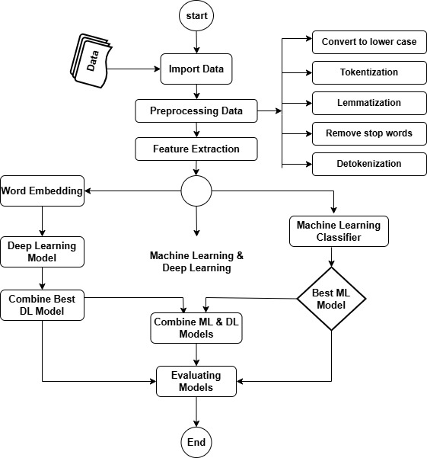
FLOW CHART

Slide 13
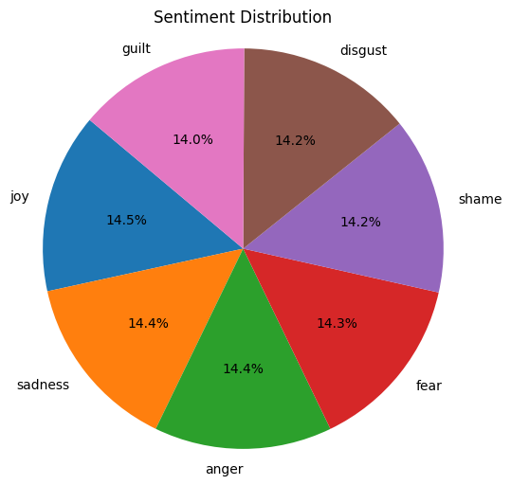
METHODOLOGY
Dataset Description:
ISEAR (International Survey on Emotion Antecedents and Reactions)
Dataset: Contains 7516 entries.
Covers 7 emotions: Joy, sadness, Anger, Fear, Shame, Disgust, guilt.
Key Features:
Equal representation for balanced model training
Diverse emotional scenarios for enhanced accuracy

Slide 14
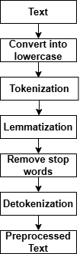
Preprocessing Steps:
Use of Preprocessing:
It also standardizes input, ensuring that the data is consistently formatted for analysis.
Preprocessing transforms raw text into a structured format for analysis.
It enhances feature extraction by identifying and isolating relevant features.
It improves model accuracy by focusing on meaningful patterns in the data.
Preprocessing Techniques:
Lowercase: Converting text into lower case.
Tokenization: Splits text into words/phrases.
Lemmatization: Reduces words to their root form like running → run.
Stop-word Removal: Filters out unimportant words like "and" or "the".

Slide 15
Feature Extraction :
Uses of Feature Extraction :
It improves model performance by helping models focus on key patterns in the data.
It captures semantic relationships, allowing models to understand the context and meaning of words.
It reduces dimensionality, with methods like TF-IDF and Label Encoding simplifying the feature space for better efficiency.
Feature Extraction Approaches:
Label Encoding: Converts categorical labels into numerical values like "joy" → 0, "sadness" → 1
TF-IDF Vectorization: Highlights important terms based on their frequency and uniqueness in the text corpus.
Word Embeddings: Provides a dense vector representation of words, capturing semantic meaning using models like Word2Vec.

Slide 16
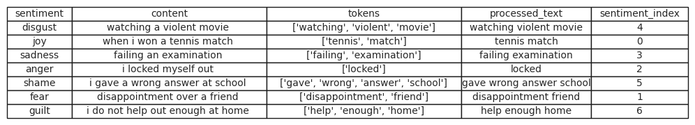
Preprocessing Result:

Slide 17
ML & DL Models :
Random Forest Classifier
Purpose: To classify emotions by creating multiple decision trees and aggregating their results for robust predictions and struggles with sequential data, missing contextual cues.
Mechanism:
Builds several decision trees using random subsets of the data and features.
Each tree votes for an emotion, and the majority vote determines the final prediction.
Advantages:
Reduces overfitting compared to single decision trees.
Handles small datasets with high dimensionality.

Slide 18
Naive Bayes Classifier
Purpose : To predict emotions based on the statistical likelihood of words and features in the text and assumes feature independence, which doesn’t hold true for complex language data.
Mechanism:
Applies Bayes’ theorem assuming all features are independent.
Calculates the probability of each emotion given the input text and selects the highest probability.
Advantages:
Simple and fast, even on large datasets.
Performs well with small or sparse data.

Slide 19
Support Vector Machine (SVM):
Purpose: Classify data into categories by finding the optimal boundary (hyperplane) between different classes.
Mechanism:
Maps data into a higher-dimensional space using kernel functions.
Separates classes by maximizing the margin between data points from different categories.
Advantages:
Works well with high-dimensional data.
Effective at handling larger datasets with clear separations.

Slide 20
Gated Recurrent Unit (GRU):
Purpose:
To capture sequential dependencies in text, understanding how word order affects emotional meaning and GRU alone might miss local text patterns that CNN captures effectively.
Mechanism:
Uses update and reset gates to control the flow of information.
Maintains memory of past data while focusing on relevant new information.
Advantages:
Efficient for modeling long-term dependencies in text.
Handles variable-length input sequences effectively.

Slide 21
Bi directional Gated Recurrent Unit (GRU):
Purpose: Understand sequences of text by capturing both past (previous words) and future (subsequent words) context.
Mechanism:
Processes text bidirectionally to capture forward and backward dependencies.
Uses gating mechanisms to regulate information flow, avoiding issues like vanishing gradients.
Advantages:
Improves comprehension of contextual relationships between words.
Handles long-term dependencies better than traditional RNNs.

Slide 22
Convolutional Neural Networks (CNN):
Purpose: Extract features from input data, typically used for image data but effective for text data as well.
Mechanism:
Applies convolutional filters to input text represented as word embeddings.
Captures local dependencies (e.g., n-grams) in the text.
Uses pooling layers to down-sample data, reducing its size while retaining essential features.
Advantages:
Effective at detecting patterns in text, such as key phrases.
Learns hierarchical structures, which are useful for emotion classification.

Slide 23
Hybrid Approach (CNN + BiGRU + SVM):
Integration:
CNN extracts local text features.
BiGRU enhances feature understanding by capturing sequence context.
SVM acts as the final classifier for robust and precise categorization.
Advantages:
Combines strengths of DL and ML models.
Achieves better accuracy by leveraging diverse techniques.

Slide 24
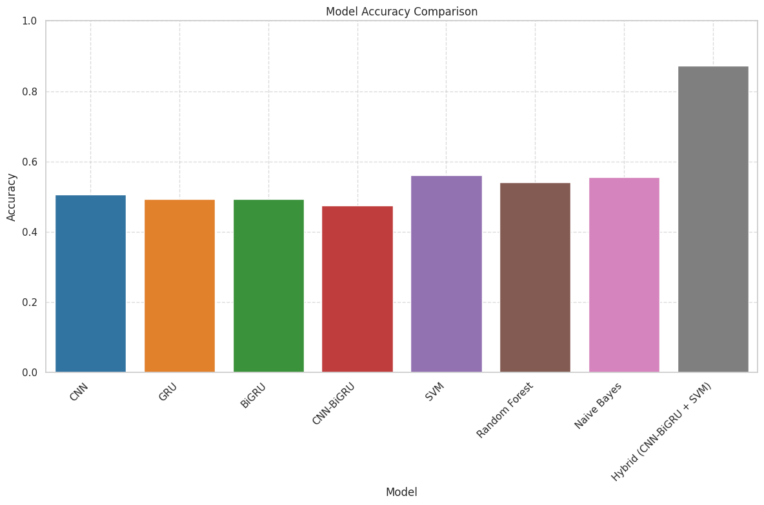
Model Performance :
Comparison of Models:
Hybrid Model: Achieves highest accuracy (86%).
DL Models (CNN, GRU, BiGRU): Moderate accuracy, effective for patterns and context.
ML Models (Naive Bayes, SVM): Lower accuracy, limited feature extraction capabilities.
Hybrid approach significantly outperforms individual techniques.

Slide 25
Evaluation Metrics of ML & DL Models:
ML Models | Accuracy | Precision | Recall | F1 Score
SVM | 0.5658 | 0.5633 | 0.5658 | 0.5637
NB | 0.5545 | 0.5385 | 0.5372 | 0.5304
RF | 0.5545 | 0.5525 | 0.5545 | 0.5501
DL Models | Accuracy | Precision | Recall | F1 Score
GRU | 0.4873 | 0.4900 | 0.4873 | 0.4790
Bi-GRU | 0.5046 | 0.5062 | 0.5046 | 0.5048
CNN | 0.5066 | 0.5098 | 0.5066 | 0.5027
Hybrid Model | Accuracy | Precision | Recall | F1 Score
CNN-BiGRU+SVM | 0.8650 | 0.8670 | 0.8650 | 0.8650

Slide 26
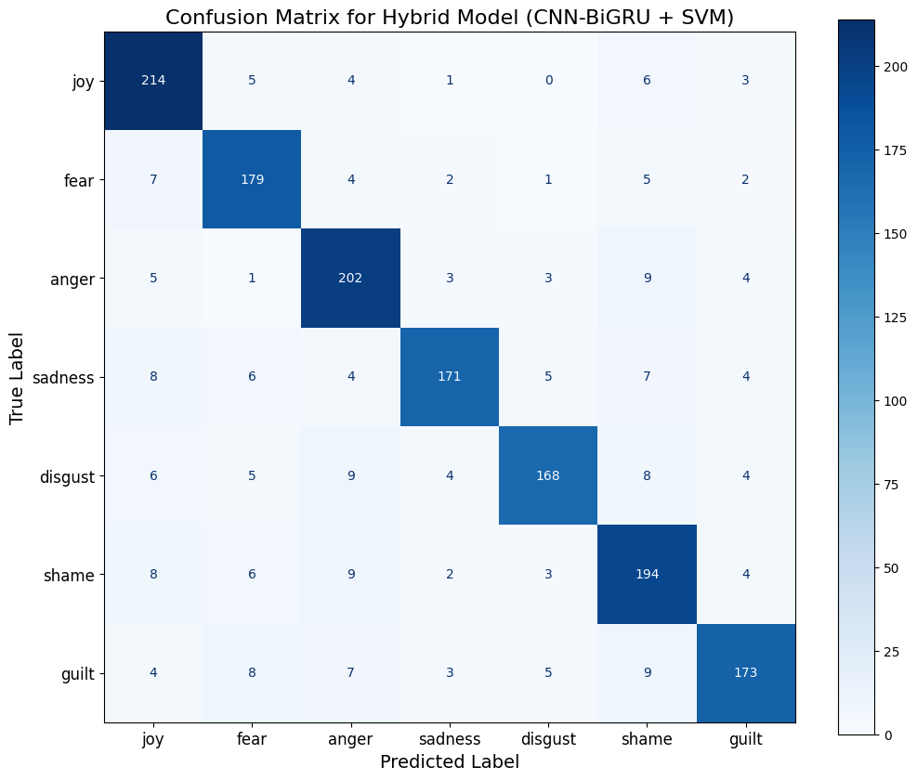
Confusion Matrix :
Visualize true positives, false positives, and misclassifications.
Highlights specific emotion categories prone to confusion.
Identifies areas for further improvement in model design.
Provides deeper insight into prediction accuracy for each emotion.

Slide 27
IMPLEMENTATION
Software Specifications:
Programming Language: Python
Libraries Used: TensorFlow, Keras, Scikit-learn, NLTK for preprocessing, and Matplotlib for visualizations.
Data Storage: ISEAR dataset in CSV format processed using Pandas.
Development Environment: Google Colab for model training and testing.
Hardware Specifications:
System: NVIDIA GPU-enabled machine for accelerated training.
Processor: Intel Core i7 or equivalent.
RAM: Minimum 16GB for handling dataset and model complexity.
Storage: SSD for faster data access and storage.

Slide 28
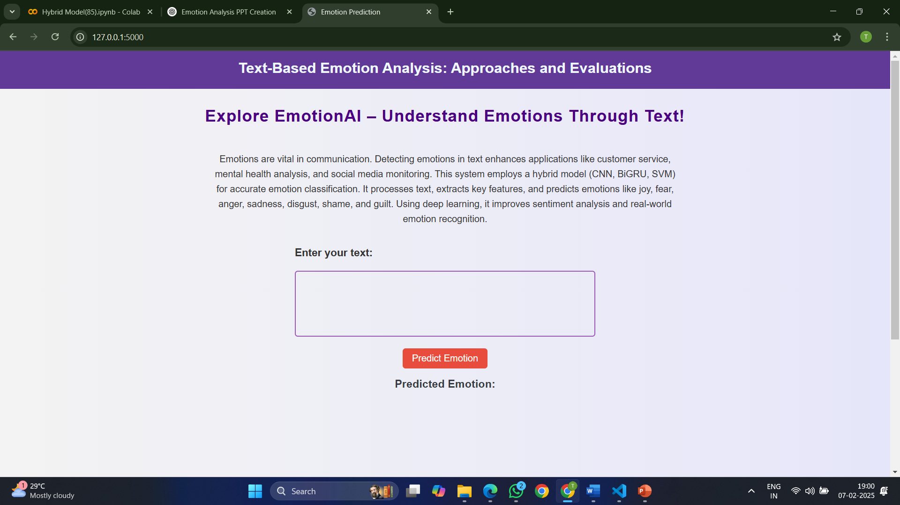

Slide 29
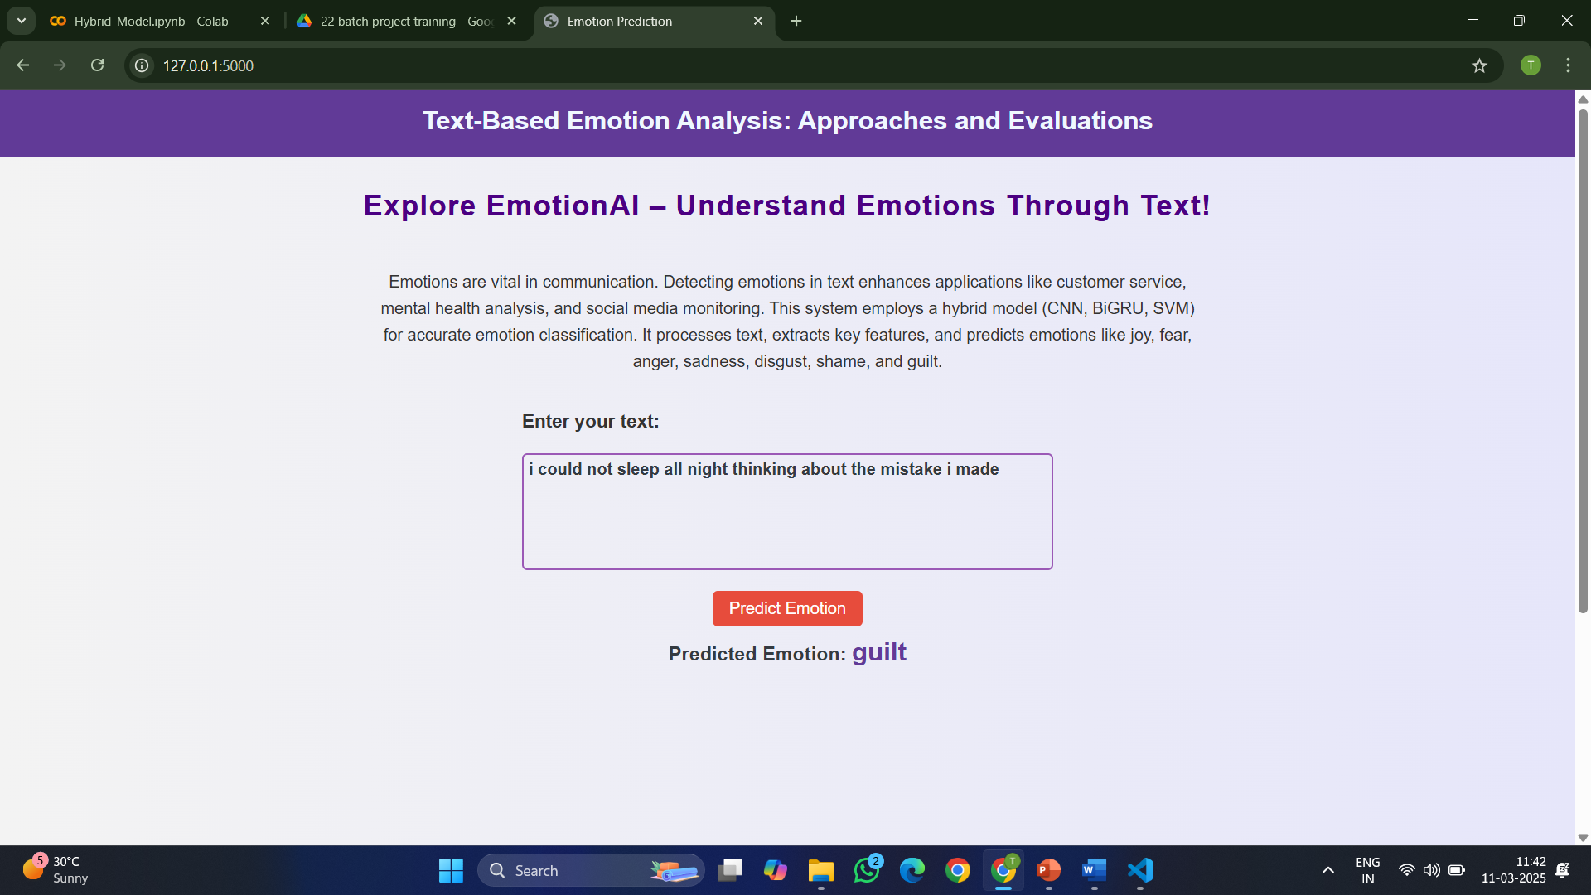

Slide 30
RESULTS & ANALYSIS
Hybrid model achieved 86% accuracy, outperforming individual ML and DL models.
Combines CNN for features, BiGRU for context, and SVM for classification.
DL models (CNN, BiGRU) showed moderate accuracy but lacked standalone sufficiency.
Traditional ML models (Naive Bayes, Random Forest) underperformed, limited in complex patterns.
Demonstrated robustness across metrics: precision, recall, F1 score and Accuracy.
Confusion matrix showed strengths in detecting "joy" and "sadness," with refinement needed for "shame" and "guilt."

Slide 31
CONCLUSION and FUTURE SCOPE
The hybrid model achieved high accuracy (86%) by combining CNN, BiGRU, and SVM, demonstrating its robustness in text-based emotion detection.
This approach successfully integrates feature extraction, contextual understanding, and classification techniques, making it a significant advancement over standalone models.
The results highlight the potential of the hybrid model in applications like customer service, sentiment analysis, and mental health monitoring.
It addresses critical challenges in emotion detection, such as handling ambiguous language and improving prediction accuracy.

Slide 32
Future Scope:
Dataset Expansion: Extend the study to include multilingual datasets and domain-specific corpora for broader applicability.
Model Optimization: Develop lighter, more computationally efficient architectures suitable for real-time emotion detection.
The results highlight the potential of the hybrid model in applications like customer service, sentiment analysis, and mental health monitoring.
Limitations:
Dataset Dependency: The model’s performance heavily depends on the quality and size of the dataset. Limited datasets, like ISEAR, may not capture all nuances of human emotions.
Subtle Emotions: Difficulty in distinguishing between closely related emotions, such as "shame" and "guilt."

Slide 33
REFERENCES
Alrasheedy, Mashary, Ravie Muniyandi, and Fariza Fauzi. Text-Based Emotion Detection and Applications: A Literature Review. 6 Oct. 2022, pp. 1-9. doi:10.1109/ICCR56254.2022.9995902.
Kumar S., S. A. ., & Geetha , A. . (2024). Emotion Detection from Text using Natural Language Processing and Neural Networks. International Journal of Intelligent Systems and Applications in Engineering, 12(14s), 609–615. Retrieved from https://ijisae.org/index.php/IJISAE/article/view/4707
Daniel Yohanesa, Jessen Surya Putraa, Kenneth Filberta, Kristien Margi Suryaningruma, Hanis Amalia Saputri 2023 Emotion Detection in Textual Data using Deep Learning Elsevier, vol 227, Pages 464-473
Santosh Kumar Bharti,S Varadhaganapathy, Rajeev Kumar Gupta, Prashant Kumar Shukla, Mohamed Bouye, Simon Karanja Hingaa, Amena Mahmoud ,2022, Text-Based Emotion Recognition Using Deep Learning Approach Hindawi Computational Intelligence and Neuroscience Volume 2022, Article ID 2645381, 8 pages https://doi.org/10.1155/2022/2645381
Ab. Nasir, A. F., Nee, E., Choong, C. S., Abdul Ghani, A. S., P P Abdul Majeed, A., Adam, A., & Furqan, M. (2020). Text-based emotion prediction system using machine learning approach. IOP Conference Series: Materials Science and Engineering, 769(1), 012022. https://doi.org/10.1088/1757-899X/769/1/012022
Patel, P., Patel, D., Patel, D., & Bera, M. (2023). Emotion detection in text: A deep learning approach for sentiment analysis. International Journal of Novel Research and Development, 8(10), 506-516.
Balapuri Shiva Sundar, Vadlakonda Rohith, Bhukya Suman, Kottoju Nagendra Chary. "Emotion Detection on text using Machine Learning and Deep Learning Techniques." International Journal for Research in Applied Science & Engineering Technology (IJRASET), Volume 10, Issue VI, June 2022. DOI: 10.22214/ijraset.2022.44293

Slide 34
Zidan, M. M. S., Elhenawy, I., Abas, A. R., & Othman, M. (2022). Textual Emotion Detection Approaches: A Survey. Future Computing and Informatics Journal, 7(1), Article 3. https://doi.org/10.54623/fue.fcij.7.1.3
Arya, P., & Jain, S. (2018). Text-based emotion detection. International Journal of Computer Engineering & Technology (IJCET), 9(3), 95–104. Retrieved from http://iaeme.com/Home/issue/IJCET?Volume=9&Issue=3.
Sohan Sai, P. (2023). ISEAR dataset [Data set]. Kaggle. https://www.kaggle.com/code/psohansai/isear/notebook
Nandwani, P., Verma, R. A review on sentiment analysis and emotion detection from text. Soc. Netw. Anal. Min. 11, 81 (2021). https://doi.org/10.1007/s13278-021-00776-6
Goru Swathi, Behara Meghana Patnaik, Arjala Janani, Kanithi Karthik, Janni Divya (2022) EMOTION RECOGNITION FROM TEXT USING MACHINE UGC CARE Listed ( Group -I) Journal Volume 11, Iss 12
D. E. Cahyani, A. P. Wibawa, D. D. Prasetya, L. Gumilar, F. Akhbar and E. R. Triyulinar, "Emotion Detection in Text Using Convolutional Neural Network," 2022 International Conference on Electrical and Information Technology (IEIT), Malang, Indonesia, 2022, pp. 372-376, doi: 10.1109/IEIT56384.2022.9967913. keywords: {Deep learning;Emotion recognition;Bit error rate;Text categorization;Data models;Convolutional neural networks;Information technology;Emotion Detection;CNN;BERT;Word2Vec;GloVe},
Sailunaz, K., Dhaliwal, M., Rokne, J. et al. Emotion detection from text and speech: a survey. Soc. Netw. Anal. Min. 8, 28 (2018). https://doi.org/10.1007/s13278-018-0505-2
Daniel Haryadi and Gede Putra Kusuma, “Emotion Detection in Text using Nested Long Short-Term Memory” International Journal of Advanced Computer Science and Applications(IJACSA), 10(6), 2019. http://dx.doi.org/10.14569/IJACSA.2019.0100645

